Slide 1
CSE1006 – Blockchain and Cryptocurrency Technologies MODULE - 4
Bitcoin Mining
Dr. Jayanthi.R

Slide 2
Content
The task of Bitcoin miners
Mining Hardware
Energy consumption and ecology
Mining pools
Mining incentives and strategies

Slide 3
The task of Bitcoin miners
Who are the miners?
How did they get into this?
How do they operate?
What's the business model like for miners?
What impact do they have on the environment?

Slide 4
The task of Bitcoin miners
We have already talked about the miners, now we will see in further detail the task of Bitcoin miners. Until now we have seen that Bitcoin depends on miners to:
store and broadcast the blockchain
validate the transactions
depending on their hash power they are able to insert new blocks and earn some reward

Slide 5
The task of Bitcoin miners
To become a Bitcoin miner, you have to join the Bitcoin network and connect to other nodes. Once you’re connected, there are six tasks to perform.
Listen for transactions.​​ First, you listen for transactions on the network and validate them by checking that signatures are correct and that the outputs being spent haven’t been spent before.
Maintain blockchain and listen for new blocks.​​ You must maintain the blockchain. You start by asking other nodes to give you all of the historical blocks that are already part of the blockchain before you joined the network. You then listen for new blocks that are being broadcast to the network. You must validate each block that you receive — by validating each transaction in the block and checking that the block contains a valid nonce.
Assemble a candidate block.​Once you have an up‐to‐date copy of the blockchain, you can begin building your own blocks. To do this, you group transactions that you heard about into a new block that extends the latest block you know about. You must make sure that each transaction included in your block is valid.

Slide 6
4. Find a nonce that makes your block valid.​ Find a nonce that is suitable to win the mathematical competition against other miners. It is necessary to work really hard to find a nonce that will make the block valid. This is the step that is more difficult from the computational point of view.
5. Hope your block is accepted.​Even if you find a block, there’s no guarantee that your block will become part of the consensus chain. Hope that the new block is accepted by the other miners. It is necessary that the following blocks are attached to the new one in order to be considered valid
6. Profit.​​ If the block is accepted the profit will correspond to the Bitcoin released during block creation and the transaction fees.
Ie:If all other miners do accept your block, then you profit!
If all other miners do accept your block, then you profit 6.25 bitcoins ( as of date)
In addition, if any of the transactions in the block contained transaction fees, the miner collects those too
So far transaction fees have been a modest source of additional income, only about 1% of block rewards
So, miners’ useful activity is to validate the transactions and blocks.
The race for block creation and the consequent reward is just an incentive for miners to do this validation.

Slide 7
The task of Bitcoin miners
We can classify the steps that a miner must take into two categories. Some tasks — validating transactions and blocks — help the Bitcoin network and are fundamental to its existence. These tasks are the reason that the Bitcoin protocol requires miners in the first place.
Other tasks — the race to find blocks and profit —‐ aren’t necessary for the Bitcoin network itself but are intended to incentivize miners to perform the essential steps.
Both of these are necessary for Bitcoin to function as a currency since miners need the incentive to perform the critical steps.
What is nonce(number used once) in blockchain?
A nonce is a value or a number that can only be used once.
Cryptographic hash algorithms and authentication protocols frequently employ nonces.
An artificially generated number used as a counter during the mining process is known as a nonce in the context of blockchain technology

Slide 8
Process to find a valid block
Now let's see what's necessary to find a new valid block. In order to do so, we have to recall that there are two hash-based data structures:
blockchain: Where each block header points to the previous block header in the chain
Merkle tree: Within each block, there’s a Markle tree. Inside every block, all of the transactions included in that block
The miners need to:
Assemble some new transactions heard from the network in a Merkle Tree
create a block with the right header pointing to the last valid block inserted

Slide 9
Process to find a valid block
3. Start searching over the nonce field and try to find a block header with a hash that starts with the required number of zeros.
The miners try to change this 32-bit nonce every time that they obtain hashes that don't satisfy the desired condition.
If a miner tries every possible 32-bit nonce and doesn't obtain a hash with the required format, he can try to modify the extra nonce.
This corresponds to the output index of the coinbase transaction. Since this transaction creates new coins, doesn't refer to an output of a previous transaction.
When this parameter is changed, the hash of the entire Merkle Tree changes, too. So, changing the extra-nonce is more computationally expensive than changing the nonce itself.
4. Finally, the miner is able to find the correct nonce before the other competitors and can broadcast the block on the network.

Slide 10
Finding a valid block by using Coinbase
The first thing that you do as a miner is to compile a set of valid transactions that you have from your pending transaction pool into a Merkle tree.
You may choose how many transactions to include up to the limit on the total size of the block.
Create a block with a header that points to the previous block and the block header has a 32-bit nonce field ( which is the actual challenge to determine)
A miner may begin with a nonce of 0 and successively increment it by one in search of a nonce that makes the block valid. See the Figure below,

Slide 11
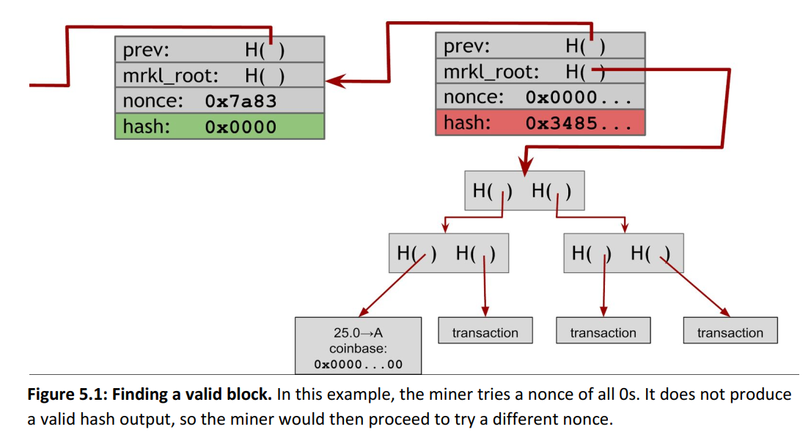
Finding a valid block by using Coinbase

Slide 12
Finding a valid block by using Coinbase
In most cases you'll try every single possible 32‐bit value for the nonce and none of them will produce a valid hash.
At this point you're going to have to make further changes.
In the above Figure there’s an additional nonce in the coinbase transaction that you can change as well.
After you’ve exhausted all possible nonces for the block header, you'll change the extra nonce in the coinbase transaction — say by incrementing it by one — and then you'll start searching nonces in the block header once again.
When you change the nonce parameter in the coinbase transaction, the entire Merkle tree of transactions has to change (See below Figure).
Changing the extra nonce in the coinbase transaction is much more expensive than changing the nonce in the block header.
For this reason, miners spend most of their time changing the nonce in the block header and only change the coinbase nonce when they have exhausted all of the 2​³² possible nonces in the block header without finding a valid block

Slide 13
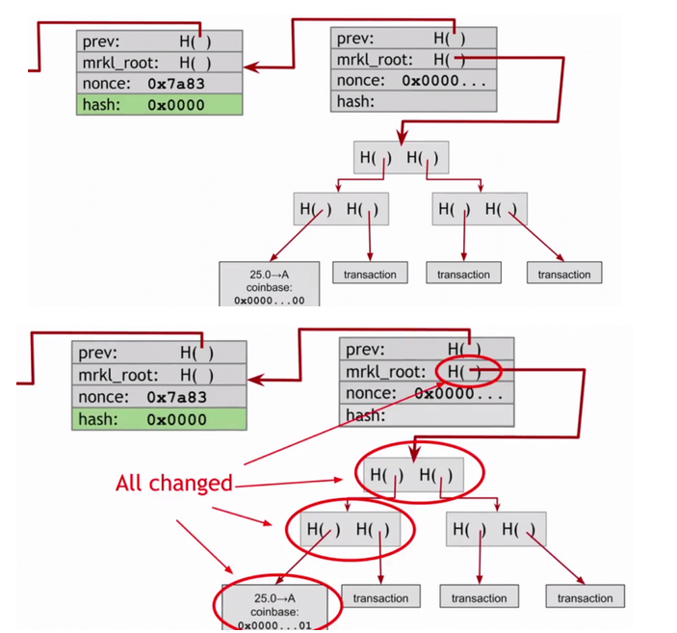
Finding a valid block by using Coinbase

Slide 14
Finding a valid block by using Coinbase
The majority of nonces that you try aren't going to work, but if you stay at it long enough you'll eventually find the right combination of the extra nonce in the coinbase transaction and the nonce in the block header that produce a block with a hash under the target.
When you find this, you want to announce it as quickly as you can profit from it.

Slide 15
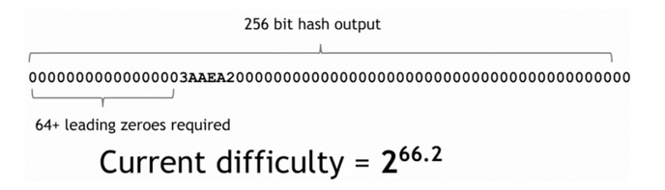
Difficulty
The difficulty depends on the number of zeros that the hash must begin with to be considered valid.
The 256-hash must begin with at least 64 bits of zeros.
As of March 2015, the mining difficulty target (in hexadecimal) is:
So the hash of any valid block has to be below this value.
The corresponding difficulty is equal to 2^{66.2}, ie: only one in about 2​^{66.2​} nonces that you try will work, which is a really huge number.

Slide 16
Difficulty
Determining the difficulty. ​
The difficulty is changed every two weeks based on how efficient the miners were over the previous two weeks.
To compute the new difficulty simply compute the ratio between two weeks and the amount of time that it took the miners to find the previous 2016 blocks.
Then the ratio is multiplied by the previous difficulty.
This is a scaling to keep valid a constant property.
The constant property is the amount of time needed to find a new block, which is 10 minutes.
formula:
next_difficulty = (previous_difficulty * 2016 * 10 minutes) / (time to mine last 2016 blocks)
Note that 2016*10 minutes is exactly two weeks, so 2016 blocks would take two weeks to mine 2016 blocks if a block were created exactly every 10 minutes.

Slide 17
Difficulty
There’s nothing special about 2 weeks, but it’s a good trade‐off
If the period were much shorter, the difficulty might fluctuate due to random variations in the number of blocks found in each period.
If the period were much higher, the network’s hash power might get too far out of balance with the difficulty.
Each Bitcoin miner independently computes the difficulty and will only accept blocks that meet the difficulty that they computed.
Miners who are on different branches might not compute the same difficulty value, but any two miners mining on top of the same block will agree on what the difficulty should be. This allows consensus to be reached.

Slide 18
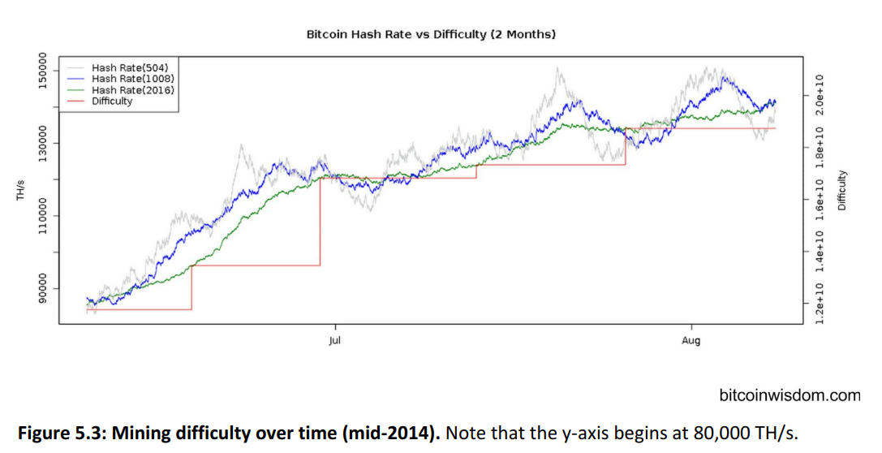
Mining Difficulty Over Time
You can see in the below Figure that over time the mining difficulty keeps increasing.
It's not a steady linear increase or an exponential increase. It depends on activity in the market
Mining difficulty is affected by factors like how many new miners are joining, which may be affected by the current exchange rate of Bitcoin.
Generally, as more miners come online and mining hardware gets more efficient, blocks are found faster and the difficulty is increased so that it always takes about ten minutes to find a block.
Below there's a step function of difficulty over two months.

Slide 19
Mining Difficulty Over Time
In the above fig, you can see that in the red line on the graph, there's a step function of difficulty even though the overall network hash rate is growing smoothly.
The discrete step results from the fact that the difficulty is only adjusted every 2016 block.
Another way to view the network’s growth rate is to consider how long it takes to find a block on average.
The figure below (a) shows how many seconds elapse between consecutive blocks in the blockchain.
You can see that this gradually goes down, jumps up, and then gradually goes down again.
Of course, what's happening is that every 2016 blocks the difficulty resets and the average block time goes back up to about ten minutes.
Over the next period the difficulty stays unchanged, but more and more miners come online.
Since the hash power has increased but the difficulty has not, blocks are found more quickly until the difficulty is again adjusted after 2016 blocks or about two weeks.

Slide 20
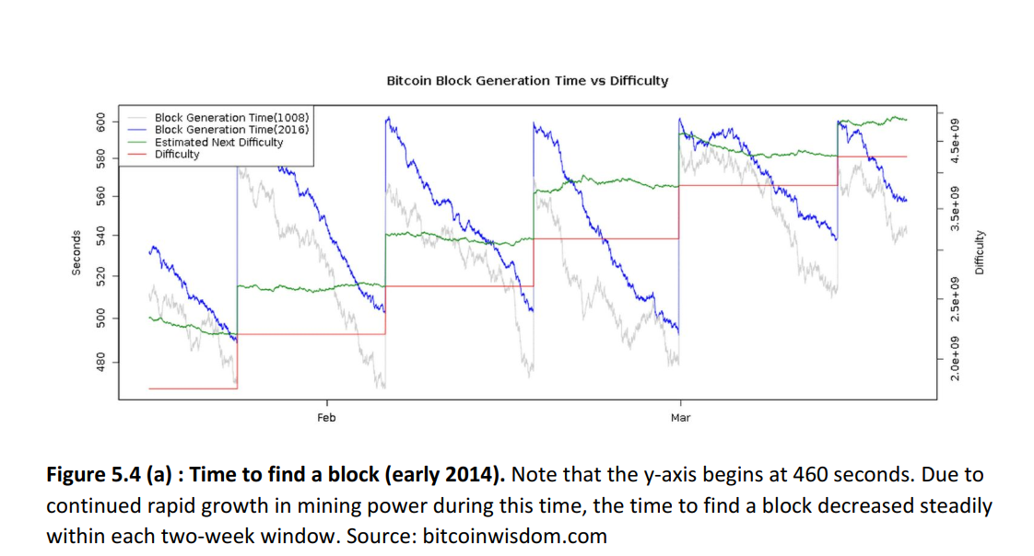
Mining Difficulty Over Time

Slide 21
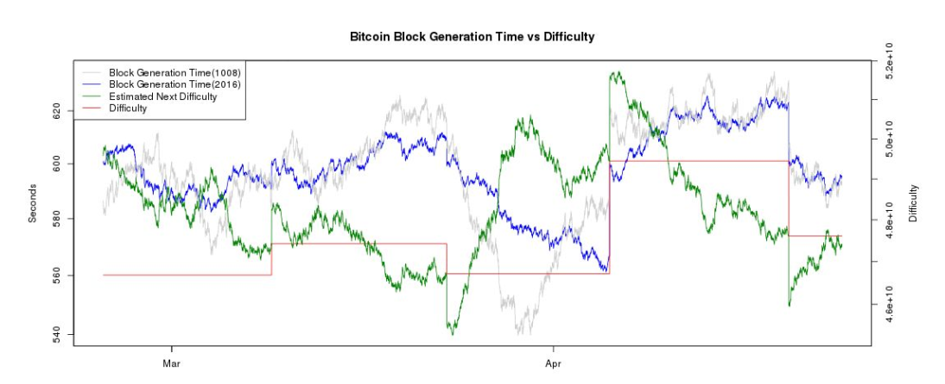
Figure (b) :
Time to find a block (early 2015). ​ Note that the y‐axis begins at 540 seconds.
As the growth of the network has slowed, the time to find each block is much closer to 10 minutes and is occasionally over during periods where the network’s hash power actually shrinks.
Even though the goal was for a block to be found every ten minutes on average, for most of 2013 and 2014 it was closer to about nine minutes on average and would approach 8 minutes at the end of each two-week cycle.
Quick calculations show that this requires an astonishing 25% growth rate every two weeks or several hundred folds per year.

Slide 22
Unsurprisingly, this was not sustainable forever and in 2015 the growth rate has been much slower (and occasionally negative).
In Figure (b), we can see that as the mining power is closer to a steady‐state, the period to find each block stays much closer to 10 minutes.
It can even take longer than 10 minutes, in which case there will be a difficulty ​ decrease​ .

Slide 23
Mining Hardware
Mining hardware used to try to win the mathematical competition.
Hash function details
We've already mentioned that the hash function used for Bitcoin is SHA-256:
SHA‐256 was a reasonable choice as this was strongest cryptographic hash function available at the time when Bitcoin was designed
It is possible that it will become less secure over the lifetime of Bitcoin, but for now it remains secure
It is a general purpose cryptographic hash function, that was standardized in 2001and it was designed by the NSA (US National Security Agency)

Slide 24
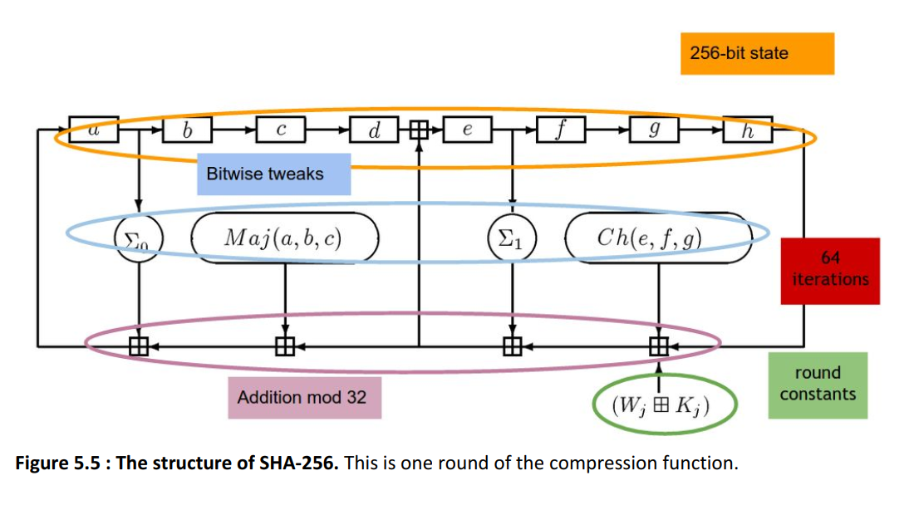
Secure Hash Algorithm (SHA-256)
Figure below shows more detail about what actually goes on in a SHA‐256 computation.

Slide 25
Secure Hash Algorithm (SHA-256)
Let's see a high level overview of SHA-256 to understand the problem that needs to be solved by the miners. In the image above we can see that:
The 256-bit state is split up in eight 32-bit words, so it's optimized for 32-bit platforms
In each round some of these words are taken. There are four different tweaks applied on them at bit-level that correspond to logic operations (bit shift, permutation, addition, ...).
Then a number of words in the state are taken and added together mod 32.
The result of all these additions is wired over to the first word of the state and the entire state shifts over
The steps 1-4 correspond to one round of SHA-256, the operation is repeated for 80 iterations.
In each iteration slightly different constants are applied, so that every reiteration isn't exactly the same as the previous ones.

Slide 26
Mining hardware in the early days
The task for miners is to compute this function as quickly as possible.
Remember that miners are racing each other so the faster they do this, the more they earn.
To do this, they need to be able to manipulate 32‐bit words, do 32‐bit modular addition and also do some bitwise logic.
The hardware used for mining has changed over the years:
CPU Mining:
The first generation of mining was all done on general purpose computers — that is general purpose Central Processing Units (CPUs).
When Bitcoin was proposed, general purpose computers where used.

Slide 27
In fact, CPU mining was as simple as running the code shown in the below
TARGET = (65535 << 208) / DIFFICULTY;
coinbase_nonce = 0;
while (1) {
header = makeBlockHeader(transactions, coinbase_nonce);
for (header_nonce = 0; header_nonce < (1 << 32); header_nonce++){
if (SHA256(SHA256(makeBlock(header, header_nonce))) <TARGET)
break; //block found!
}
coinbase_nonce++;
}
That is, miners simply searched over nonces in a linear fashion, computed SHA 256 in software and checked if the result was a valid block.
Also, notice in the code that as we mentioned, SHA‐256 is applied twice.

Slide 28
How fast will this run on a general purpose computer? On a high‐end desktop PC you might expect to compute about 20 million hashes per second (MH/s).
At that speed, it would take you several hundred thousand years on average at the early‐2015 difficulty level (2​ ^{67​}) to find a valid block.
Throughput on a highend PC 10-20 MHZ ≈ 2²⁴ hashes per second
If you're mining on a general purpose PC today, CPU mining is no longer profitable with the current difficulty.
For the last few years, anyone trying to mine on a CPU probably doesn’t understand how Bitcoin works and was disappointed that they never made any money doing it

Slide 29
GPU Mining:
After the CPU, the graphic processing units (GPU) started to be used.
The graphic cards are designed to have a high parallelism, which helps with Bitcoin mining.
In fact, they let compute multiple hashes at the same time for different nonces.
The graphic cards are easily available and are easy to set up for computing hashes.
In addition, it is possible to attach many graphic cards to one single motherboard and CPU.
Many miners started to run many graphic cards and tried to optimize the process to be as fast as possible.
However graphic cards are not designed to compute hashes, so they don't have great cooling systems especially when there are a lot of graphic cards near each other.
They also use more electricity than the one necessary to compute hashes since they are designed for graphical rendering and not only for mathematical computations.
The best GPU systems, that used around 100 GPU, were able to reach the 200 MegaHertz.

Slide 30
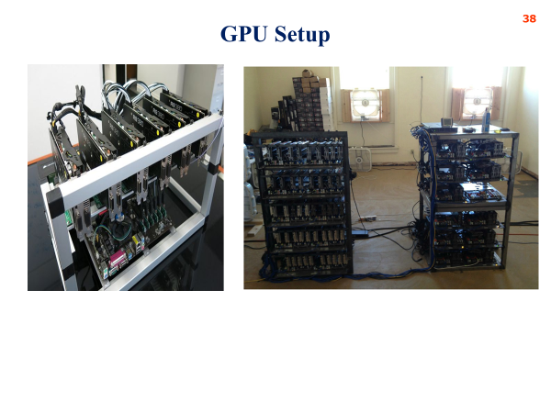
GPU Mining hardware setup

Slide 31
Disadvantage GPU Mining
GPUs have a lot of hardware built into them for doing video processing that can’t be utilized for mining
Specifically, they have a large number of floating point units that aren’t used at all in SHA‐256
GPUs also don't have the greatest cooling characteristics when you put a lot of them next to one another
They’re not designed to run side by side as they are in the picture; they're designed to be in a single box doing graphics for one computer

Slide 32
Advanced mining hardware
After 2011, miners started to use more specific and advanced hardware:
FPGA (Field Programmable Gate Arrays):
FPGA have hardware like performances, but let the owner of the card customize it.
So they are faster that GPU and it's easier to set up FPGA racks since less cooling is necessary.
FPGAs offer better performance than graphics cards, particularly on “bit manipulation” operations on FPGA
You can theoretically use nearly all of the transistors on the card for mining
Like GPUs, you can pack many FPGAs together and drive them from one central unit
Overall, it was possible to build a big array of FPGAs more neatly and cleanly than you could with graphics cards.
Bitcoin mining requires to make FPGAs work harder than what they were designed for. So there was a lot of malfunctioning and they were less accessible for common people.
The best solutions using FPGA let the miners reach 1 GigaHertz and they were a popular solution for miners for around a year.
With today difficulty, it would still take around 25 years to find a new block.

Slide 33
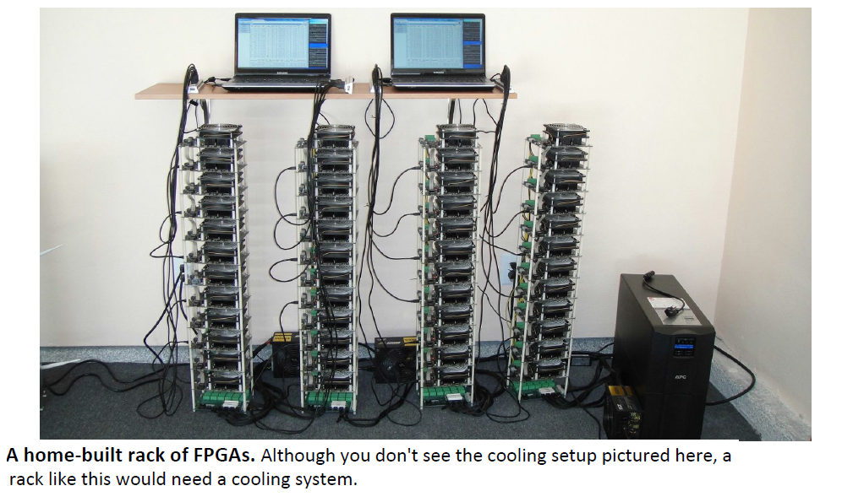
FPGA Setup

Slide 34
Disadvantage of FPGA
They have been driven harder for bit coin mining
They have to be overclocked leading to more heat dissipation and malfunction during mining
It also turned out to be difficult to optimize the 32‐bit addition step which is critical in doing SHA‐256
FPGAs are also less accessible‐ not available in many stores and there are fewer people who know how to program and set up an FPGA than a GPU
FPGAs improved performance, but the cost‐per‐performance was only marginally improved over GPUs

Slide 35
Advanced mining hardware
2. ASIC (Application Specific Integrated Circuits):
Chips designed and build from scratch to do nothing except mining Bitcoins.
In the last few years many companies started to produce ASICs and there are a lot of choices when a miner decides to buy one.
There are models with different cost, computing power, energy consumption and shipping times.
It is really important to consider delivery options, since there are many new companies rising that require consumer to pay before the chip is ready.
There are many known cases in which the ASICs took a lot of time to be delivered, were never sent or were full of bugs.
An ASIC as the one below is able to compute 2 TeraHash per second. So it's 1000 times faster than an hypothetical array of 100 really good FPGA.
It now costs around 3000$. Even with this incredible performances are still necessary 14 months to find a new block.
Due to the cost and the dynamics to buy them, it is very difficult for a small miner to go online in a profitable way.

Slide 36
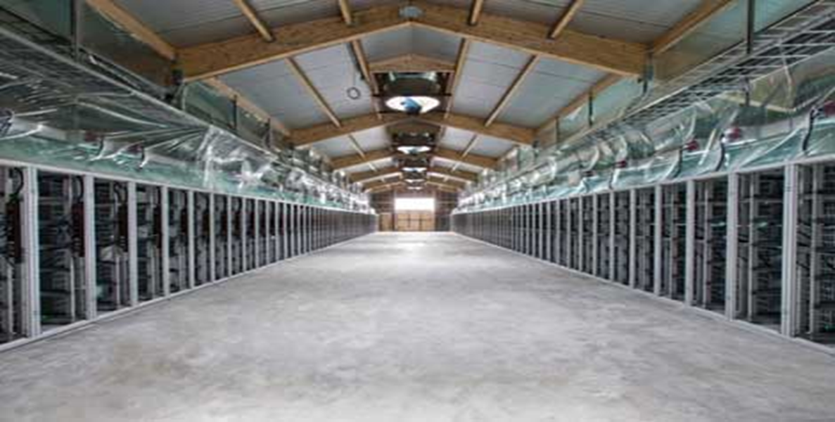
Professional Mining – Current Era in Bitcoin Mining
Many professional centers popping up around the world, especially in China
To open a professional center it is necessary to have cheap energy, good network connectivity, a cool climate so that it is not necessary to spend too much on cooling systems
Some popular destinations for this purpose are for example Georgia and Iceland

Slide 37
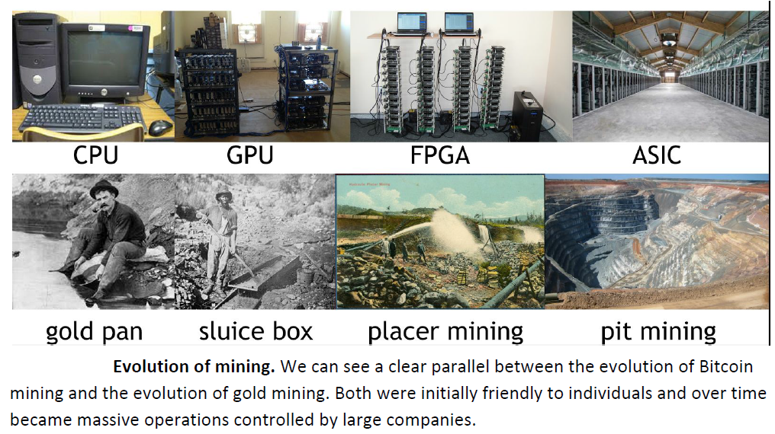
Gold and Bitcoin Mining Evolution

Slide 38
Energy Consumption and Ecology

